Slide 1

Findings from OTA Booking Data Analysis
Tarun Tyagi –Oct 8 2024

Slide 2
Introduction
Analyze OTA booking data to uncover insights that drive sales and customer engagement.
Utilize diverse data fields, including buyer and supplier IDs, journey types, and pricing information.
Identify patterns in customer behavior, supplier performance, and seasonal trends.
Propose targeted strategies to enhance marketing efforts and optimize operations for improved profitability.

Slide 3
Methodology
Data Collection: Sourced OTA booking records and performed data cleaning.
Data Exploration: Conducted exploratory data analysis to identify key metrics.
Analysis Techniques: Applied statistical methods and visualizations for insights.
Tools Used: Utilized Python libraries such as pandas and Matplotlib.

Slide 4
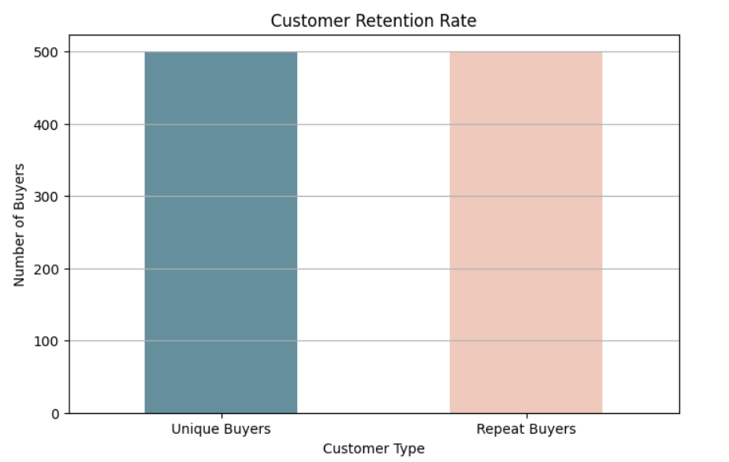
Customer Retention Rate

Slide 5
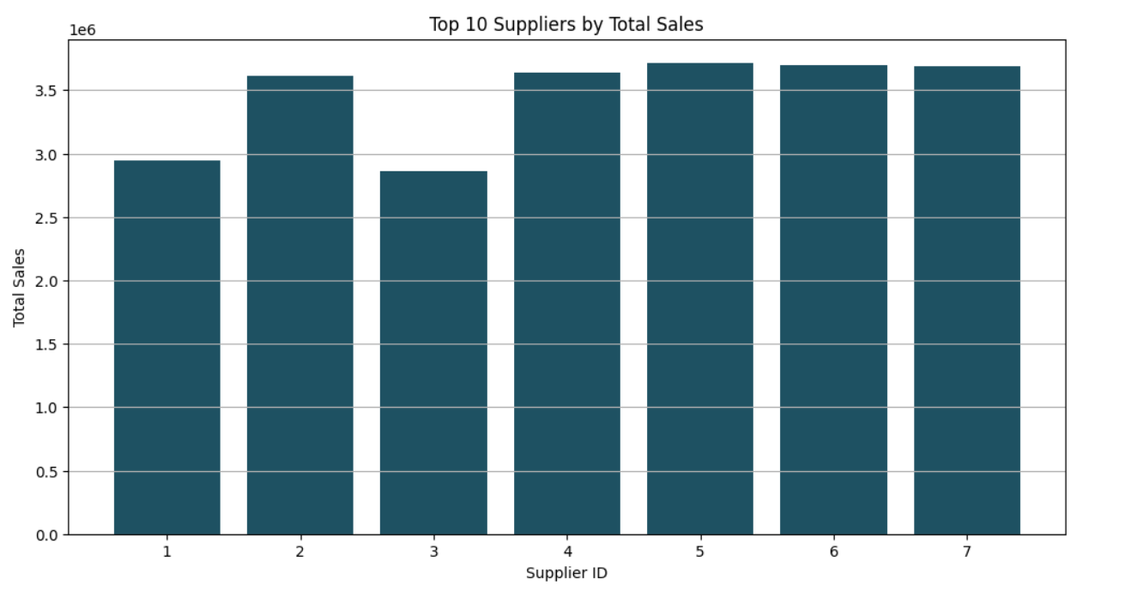
Supplier Performance

Slide 6
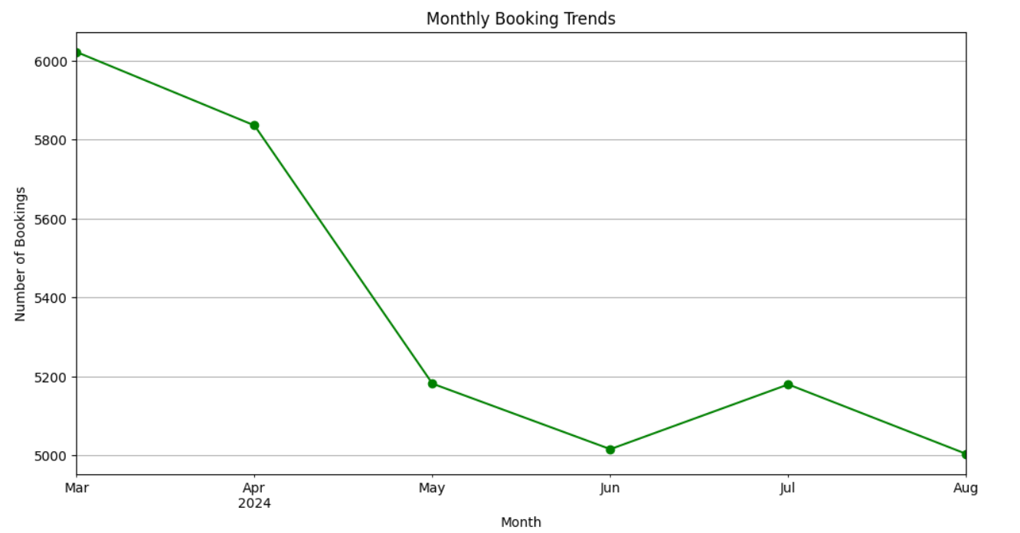
Booking Trends Over Time

Slide 7
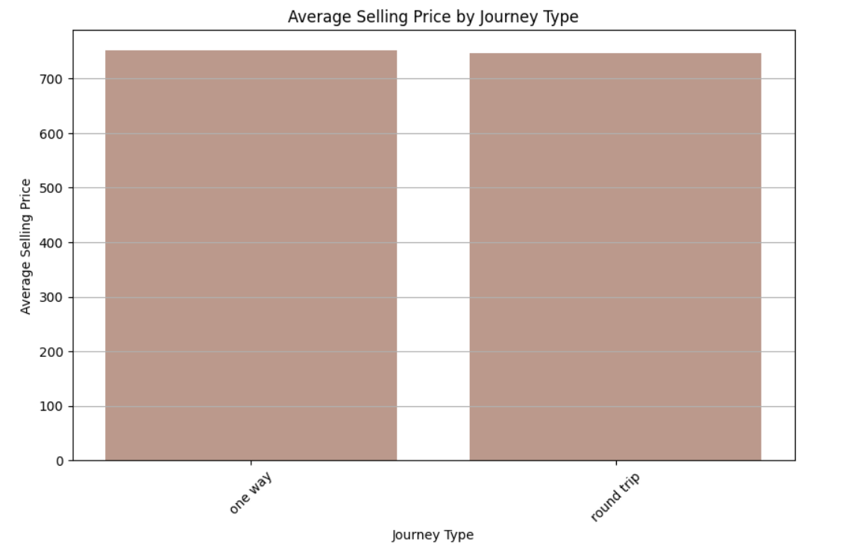
Average Selling Price by Journey Type

Slide 8
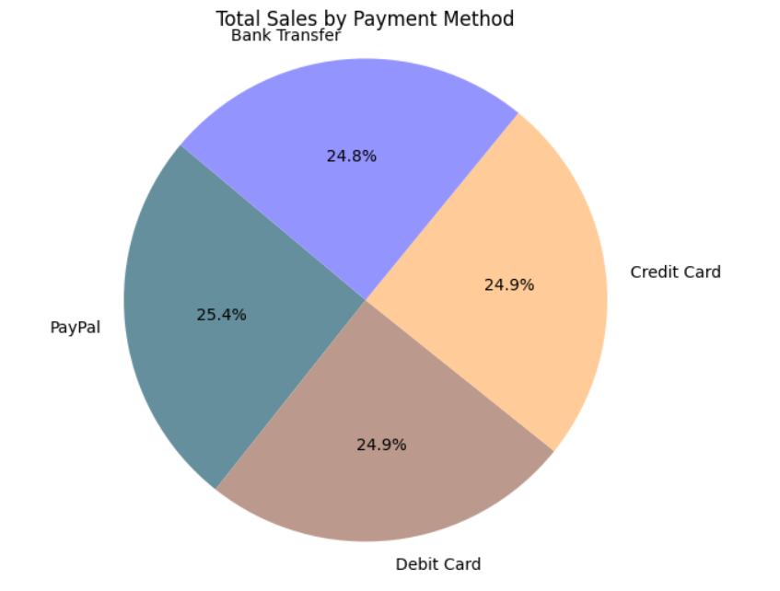
Payment Method Analysis

Slide 9
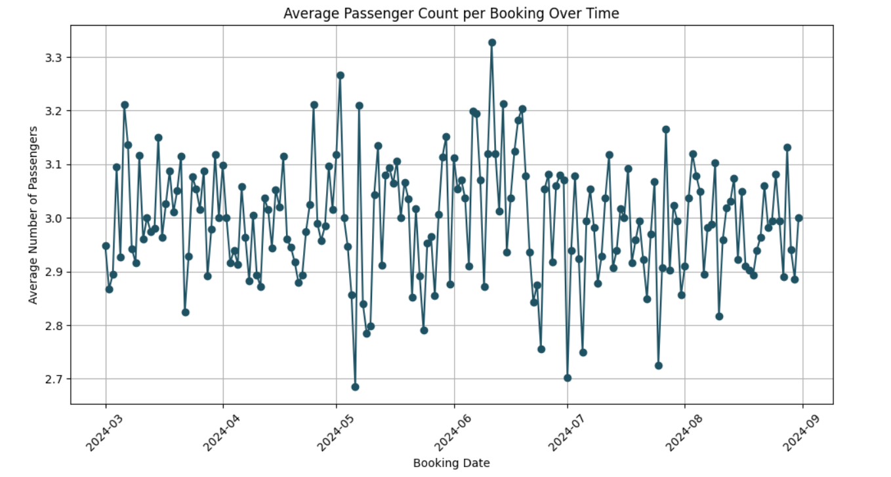
Average Passenger Count per Booking

Slide 10
Summary of Findings
Recap of all findings.

Slide 11
Recommendations
Actionable strategies based on findings.

